Slide 1

BUSINESS PLAN
BY
PADMA PRIYA V - 111720102094 - CSE B
KALAIVANI B - 111720102051- CSE B

Slide 2
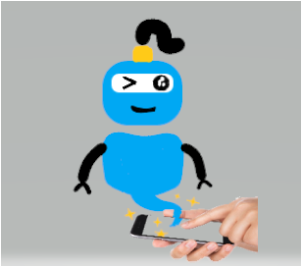
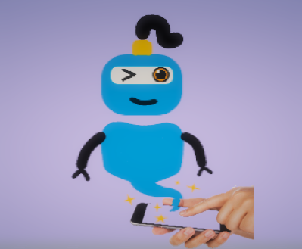
63% of customers will leave a company after just one poor experience, and almost two-thirds will no longer wait more than 2 minutes for assistance. So, chatbots are in great demand now.
GENIE
YOUR WISH IS MY COMMAND

Slide 3

SERVICE BASED
SOFTWARE INDUSTRY
INDUSTRY
BUSINESS
TYPE
PRODUCT
GENIE
OUR BUSINESS
AI CHATBOT
BUSINESS
NAME
PROS
TARGET
REDUCE WORKLOAD
EXCLUSIVE USAGE

Slide 4
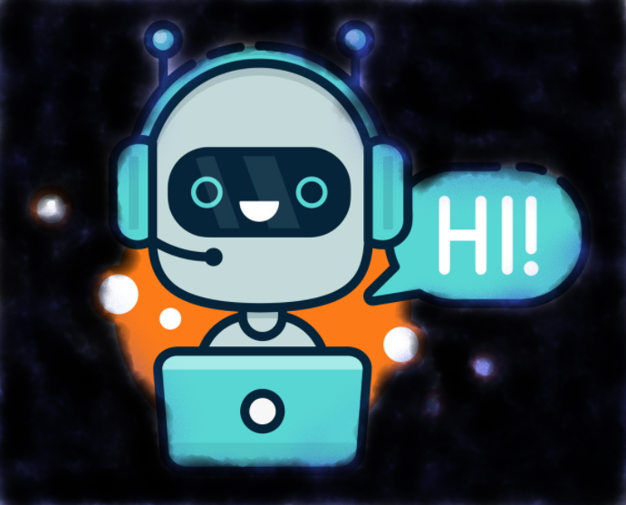
WHAT IS A CHATBOT?
“ELIZA”, THE FIRST EVER CHATBOT WAS DEVELOPED BY JOSEPH WEIZENBAUM IN 1966
A chatbot is a computer program that simulates human conversation through voice commands or text chats or both.
They make the user feel understood and helped.
They create rapport with the user, without pretending to be human.

Slide 5
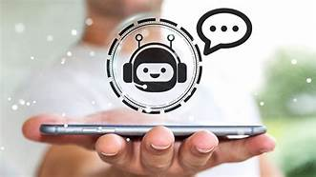
WHY?
INSTANT REPLY
HANDLES ROUTINE REQUESTS EFFICIENTLY
01
04
ADDRESSES LARGE NUMBER
OF SIMPLE INQUIRIES
ADVANCED TECHNOLOGY IN LIEU OF HUMAN AGENT
02
05
MAKES PRODUCT SUGGESTIONS
03
06
AVAILABLE 24/7

Slide 6
BUSINESS PLAN
1
ANALYZE BOTS’ AUDIENCE
2
IMPLEMENT NATURAL LANGUAGE PROCESSING AND ARTIFICIAL INTELLIGENCE
DECIDING CHATBOT COMPONENTS TO HOLD A CONVERSATION SUCH AS
INTENTS
ENTITIES
DIALOG
3
4
TESTING FOR UPGRADATION
5
OPTIMISE, ENHANCE AND REDUCE TURNAROUND

Slide 7
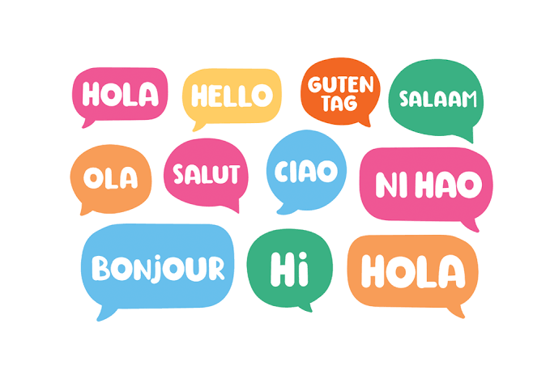
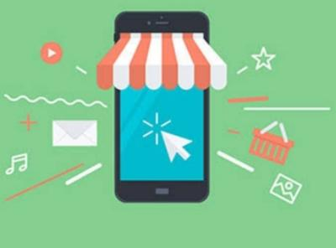
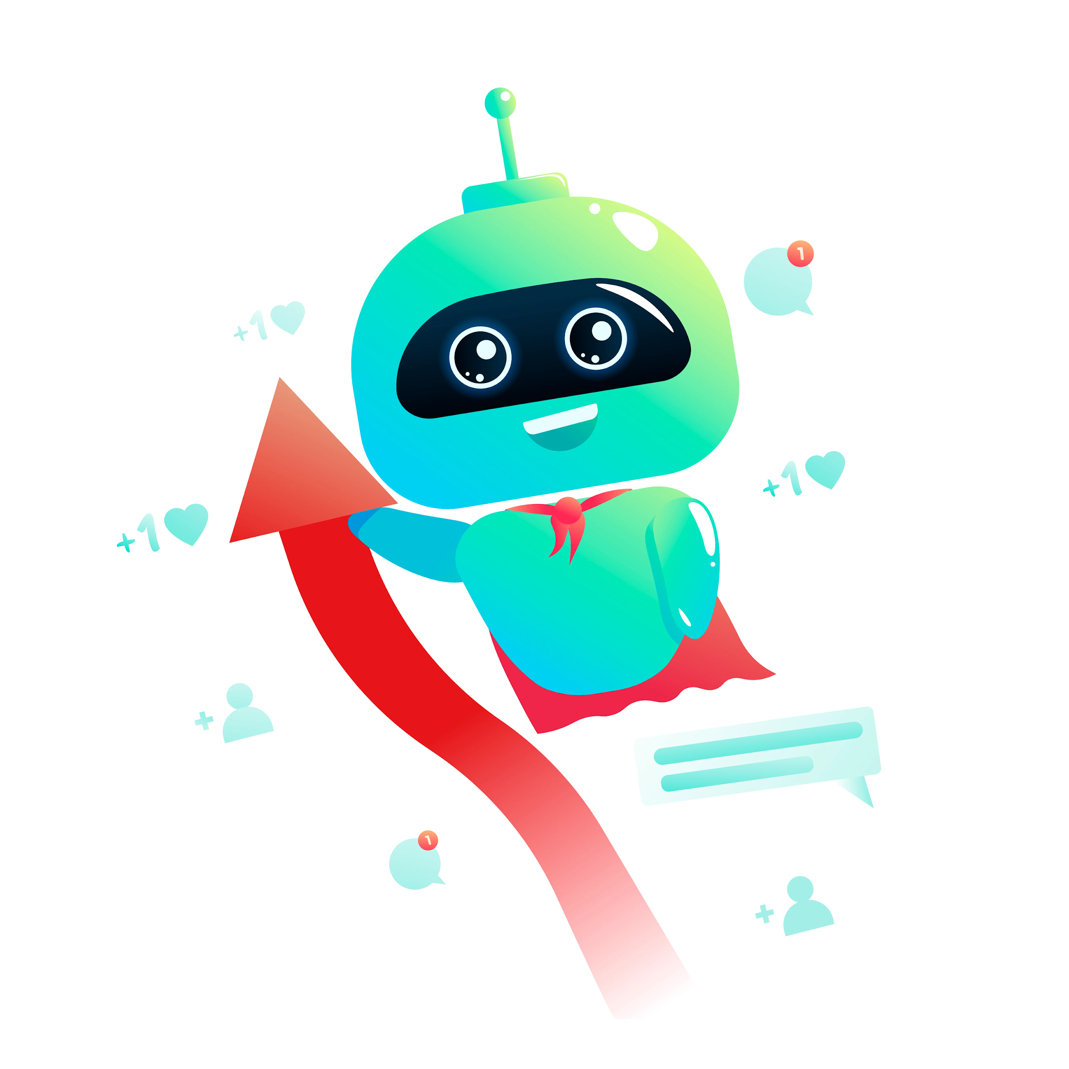
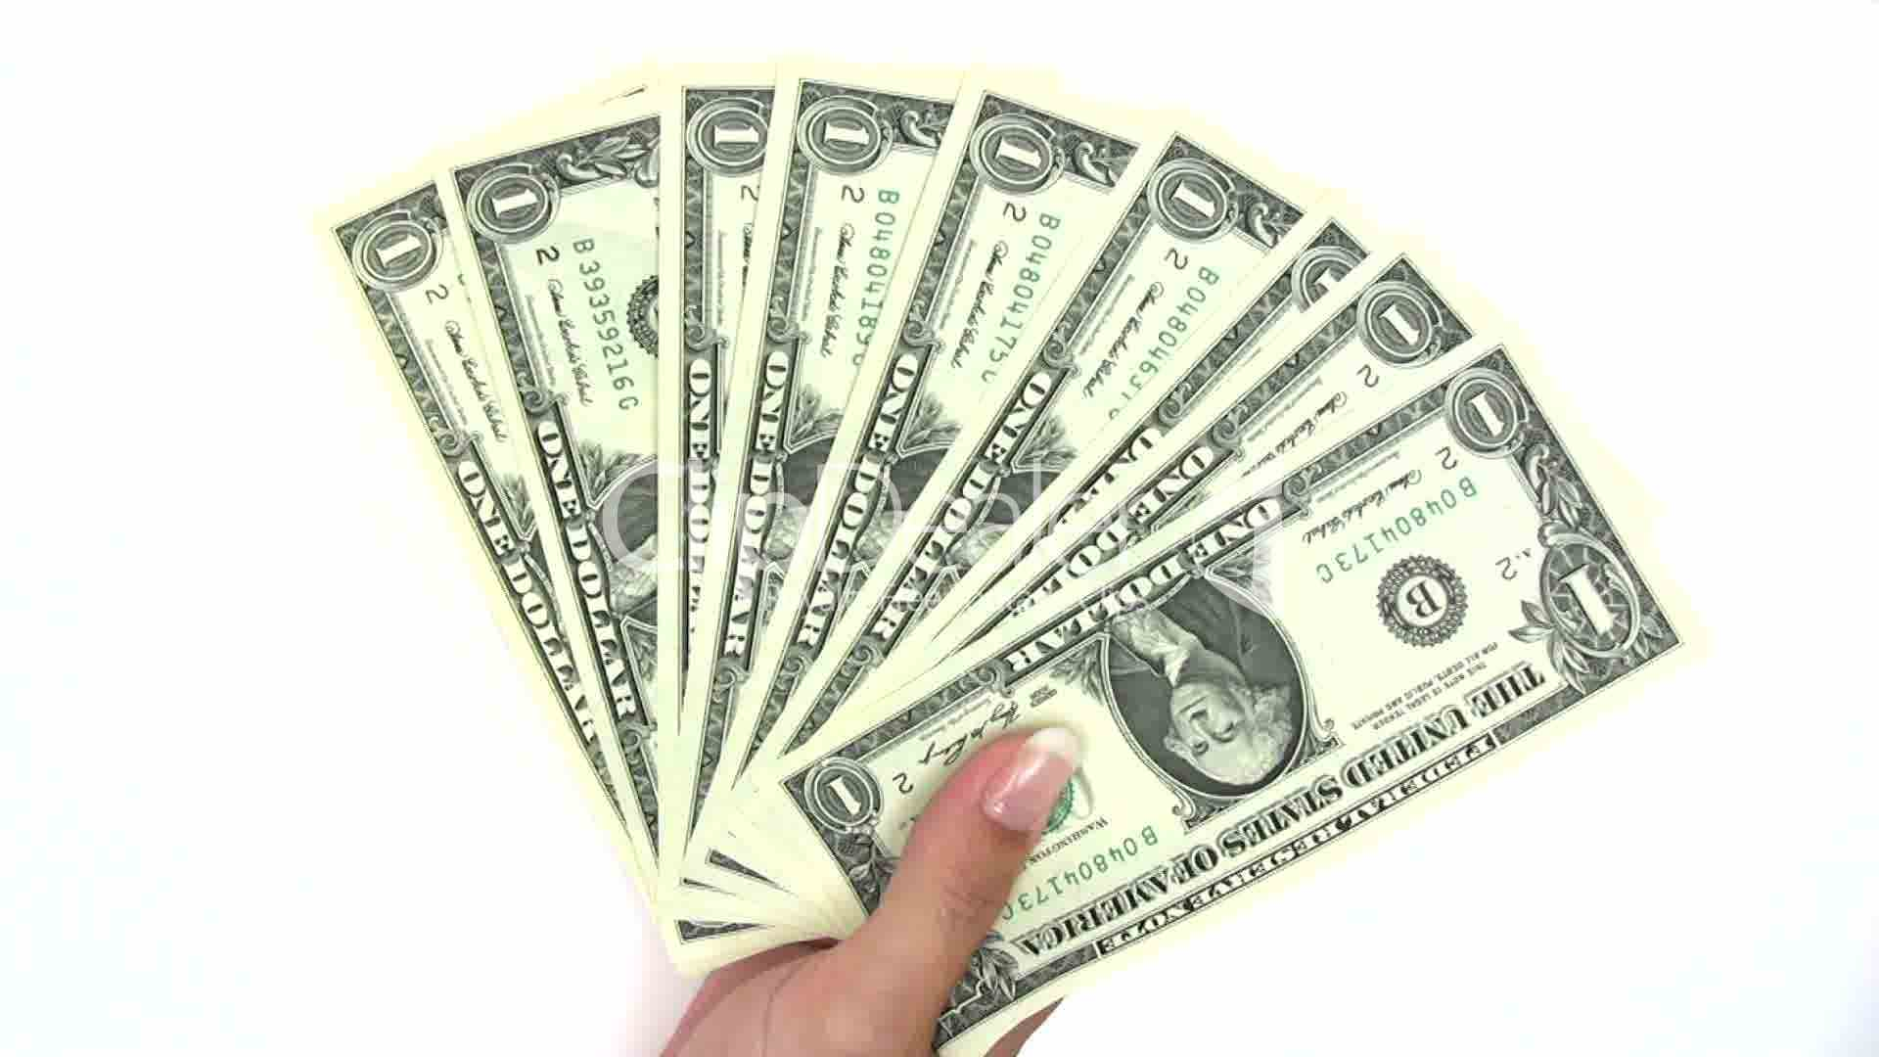
EFFECTIVE CUSTOMER SERVICE
MULTILINGUAL
NOT CONFINED TO A SINGLE FIELD
PHONE, FAX, CHAT AND OTHER MULTI CHANNEL OPTIONS
PRODUCT
PLACE
ADVERTISING IN TELEVISION CUM SOCIAL MEDIA
SALES PROMOTION
DIRECT MARKETING
PUBLIC RELATIONSHIP
ESTABLISHING TIE-UPS WITH MUTUAL CLIENTS
FREE TRIAL FOR A WEEK
TECHNICAL ERRORS WITHIN THE WARRANTY PERIOD WILL BE SORTED OUT ASAP
PROVISION OF 3 HIERARCHIAL SERVICES (RESPECTIVE COSTS)
PROMOTION
＄
PRICE

Slide 8
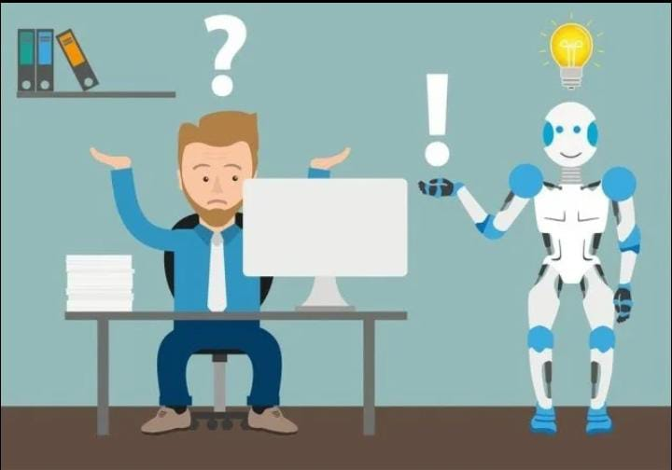
STRATEGIES
PRIORITIZING USE CASES
IMPROVISATION
Gathering feedback from former users and stakeholders to improve bot experience
Each business has its own unique priorities and objectives.
AUTOMATION
SECURITY
Automate our model according to the bot’s audience
Integrates securely with backend systems to deliver more meaningful experience.
CUSTOMER INTERACTION
BOT AS BRAND AMBASSADOR
Transforming the way of meeting customers’ needs.
Fascinates the customers and convinces them to buy the product.

Slide 9
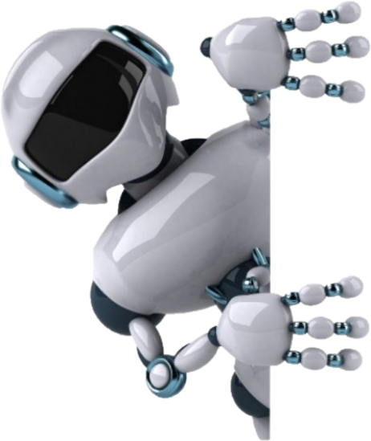
OPERATION
USER
UTTERANCE
APP/
DEVICE
QUERY
ACTIONABLE DATA
CHECKING INTENTS
MATCHING INTENTS
DATABASE
EXTERNAL API

Slide 10

FINANCIAL PLAN
VELLEITY
1-3 BOT OPT-IN POINTS (WEBSITE CHAT)
5 WEBHOOK CONNECTIONS
RS 40,000 AND MAINTENANCE CHARGES
WISH
4-8 BOT OPT-IN POINTS (WEBSITE CHAT)
6-10 WEBHOOK CONNECTIONS
RS 65,000 AND MAINTENANCE CHARGES
DESIRE
9-15 BOT OPT-IN POINTS (WEBSITE SITE)
11-15 WEBHOOK CONNECTIONS
RS 80,000 AND MAINTENANCE CHARGES
PARTICULARS: CLOUD STORAGE, PROGRAMMER, PROMOTIONAL ADS

Slide 11
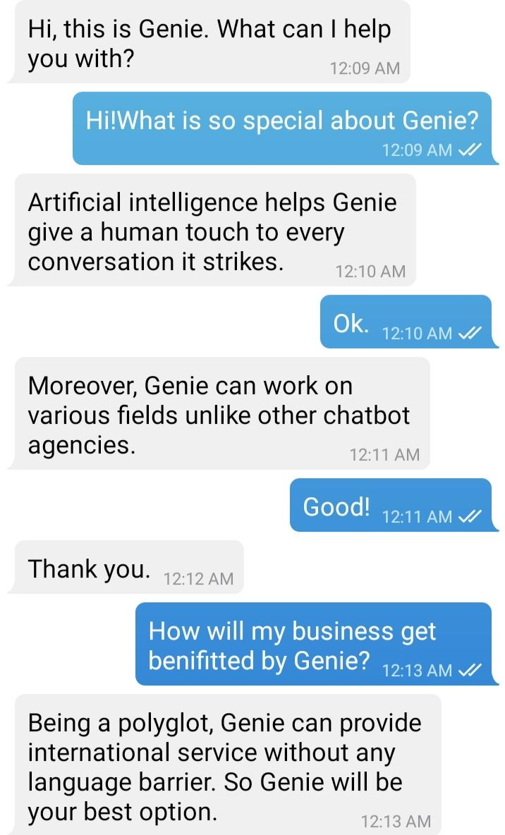

WHY GENIE?

Slide 12

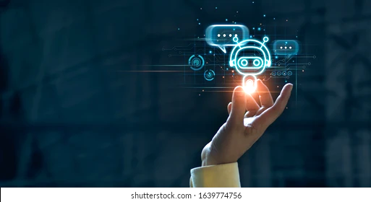
THANK YOU!
GET A CHATBOT
OR
GET LEFT BEHIND!!!

